Slide 1

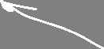


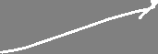
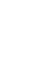


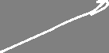
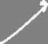
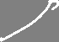


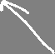
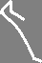
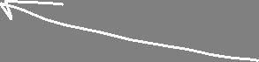

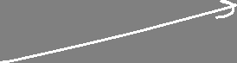
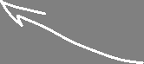


Sequence models in deep learning
Angelo Ziletti, PhD
Principal Data Scientist, Bayer AG

Slide 2
Lecture Outline
Part 1.
Recurrent Neural Networks (RNNs)
1
Part 2.
Long Short Term Memory (LSTM)
2
Part 3.
Tutorials
3

Slide 3
Main references for this class
Dive into Deep Learning (https://d2l.ai/)
Authors: Aston Zhang and Zachary C. Lipton and Mu Li and Alexander J. Smola
Interactive deep learning book with code, math, and discussions
Implemented with NumPy/MXNet, PyTorch, and TensorFlow
Adopted at 140 universities from 35 countries
Deep Learning, MIT Press Book (https://www.deeplearningbook.org/)
Authors: Ian Goodfellow and Yoshua Bengio and Aaron Courville
Introduction to Deep Learning (MIT online course) http://introtodeeplearning.com/
Authors: A. Amini, and A. Soleimany

Slide 4
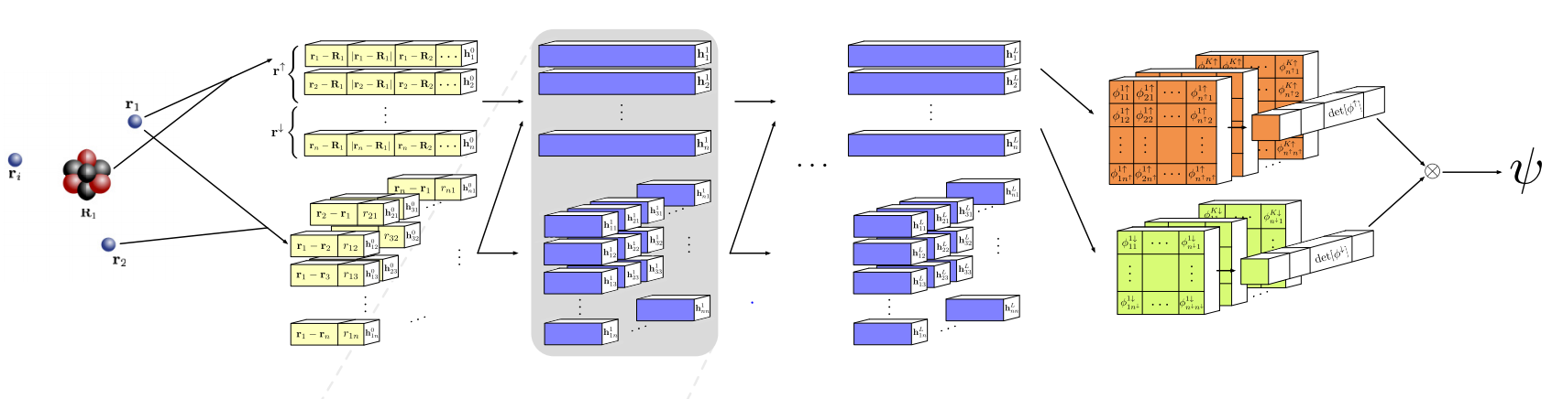
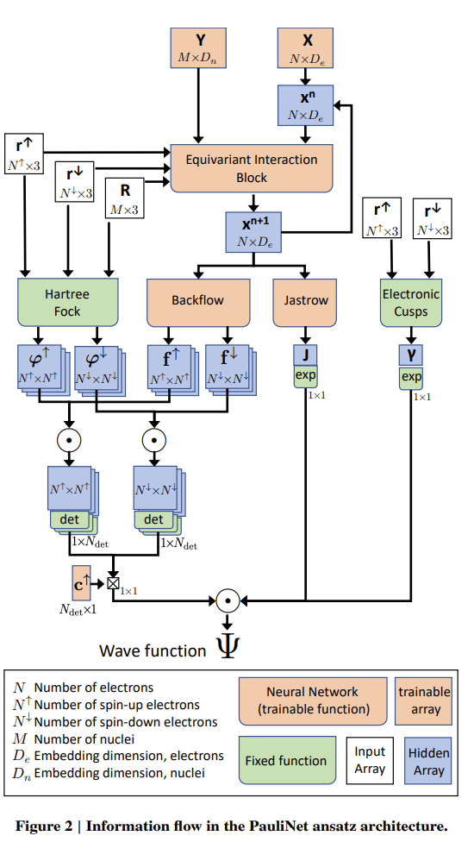
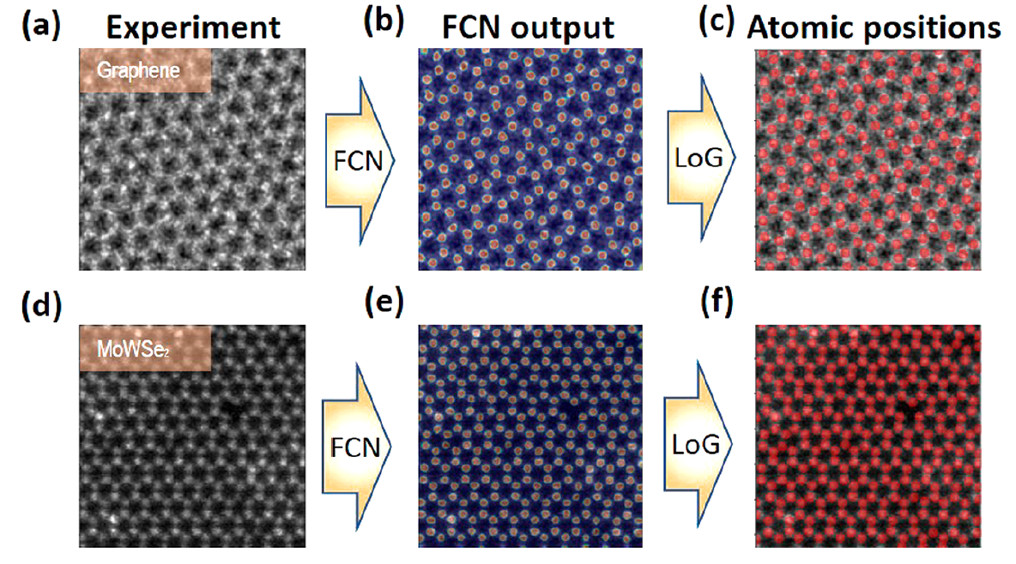
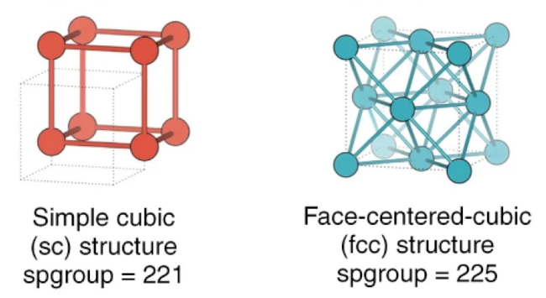
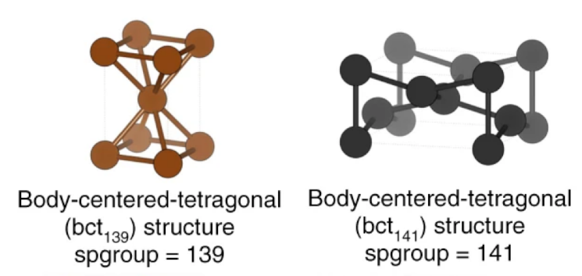
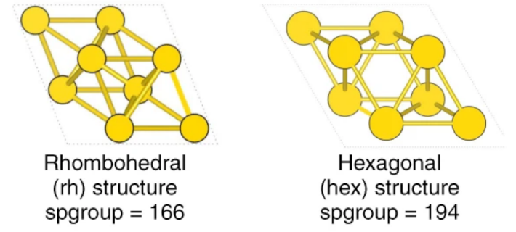
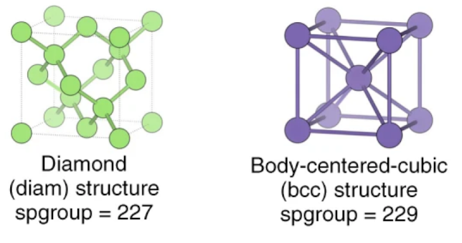
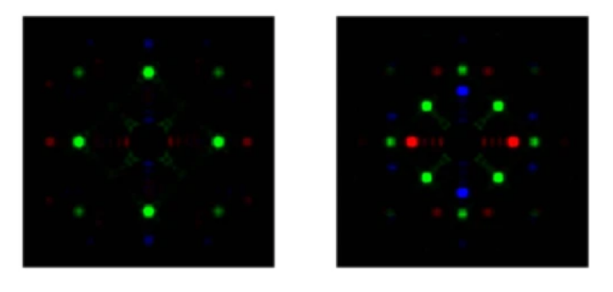
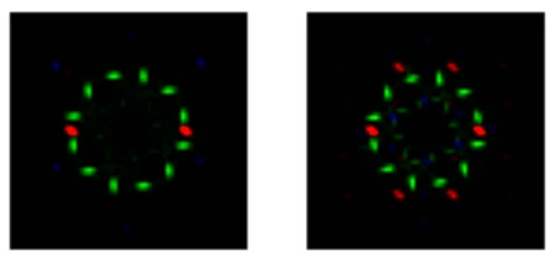
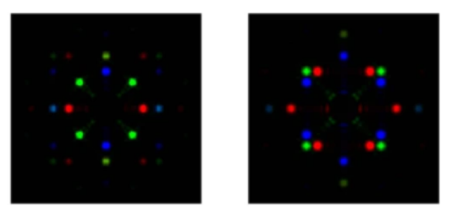
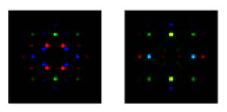
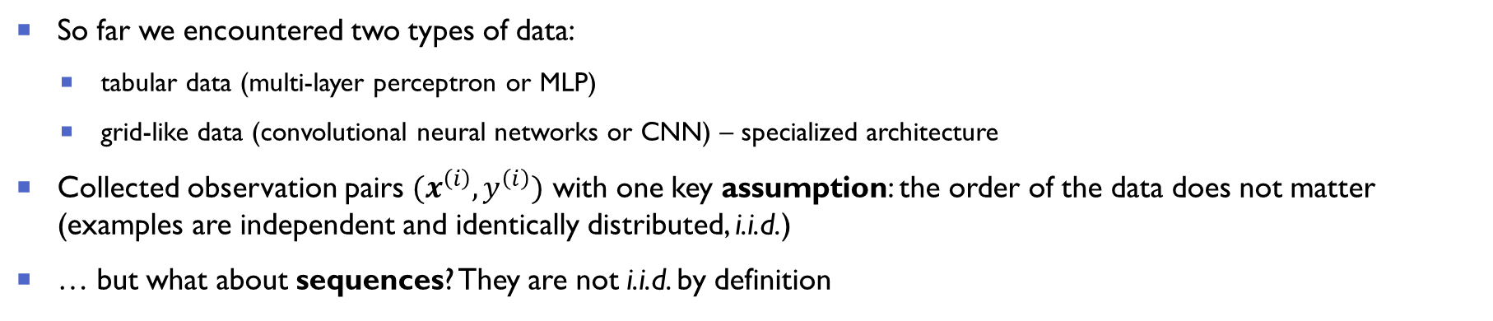
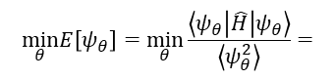
When the order of the data matters
So far we encountered two types of data:
tabular data (multi-layer perceptron or MLP)
grid-like data (convolutional neural networks or CNN) – specialized architecture
Collected observation pairs $(x^{\left(ⅈ\right)},y^{\left(ⅈ\right)})$ with one key assumption: the order of the data does not matter (examples are independent and identically distributed, i.i.d.)
… but what about sequences? They are not i.i.d. by definition
$$\min_{θ}E\left[ψ_{θ}\right]=\min_{θ}\frac{\left\langle ψ_{θ}\left|\hat{H}\right|ψ_{θ}\right\rangle }{\left\langle ψ_{θ}^{2}\right\rangle }=$$
Hermann et al., Nat. Chem. 12, 891 (2020)
Pfau et al., Phys. Rev. Research 2, 033429 (2020)
M. Ziatdinov et al., ACS nano 11, 12742 (2017)
A. Ziletti et al., Nature Communications, 9, 2775 (2018)

Slide 5
Predictions based on sequences
Some applications:
Speech recognition
Music generation
Sentiment classification of text
Machine Translation
DNA sequence analysis
In physics/materials science:
Any ideas?
Treat experimental spectra or in general any temporal signal
Molecular properties (molecule seen as a sequence)

Slide 6
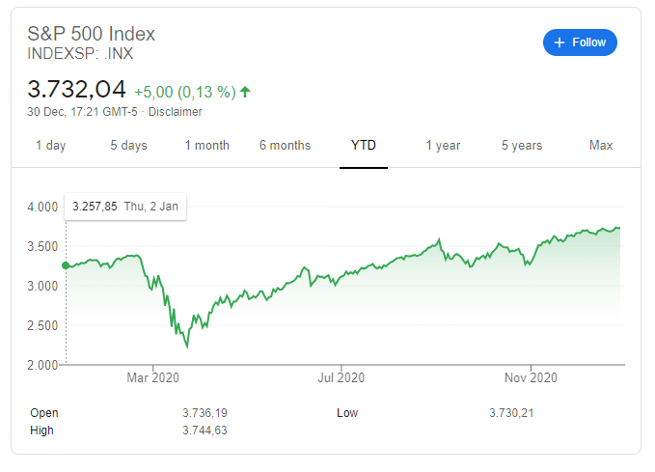
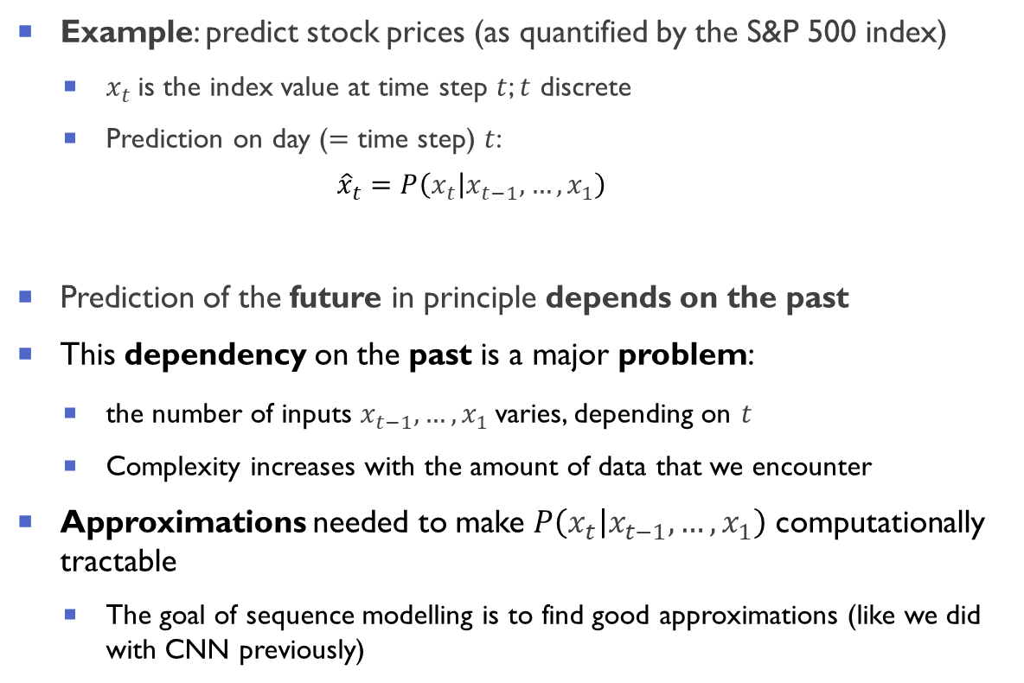



Sequence model
Example: predict stock prices (as quantified by the S&P 500 index)
$x_{t}$is the index value at time step $t$; $t$ discrete
Prediction on day ($=$ time step) $t$:
$${\hat{x}}_{t}=P\left(\left.x_{t}\right|x_{t−1},…,x_{1}\right)$$
Prediction of the future in principle depends on the past
This dependency on the past is a major problem:
the number of inputs $x_{t−1},…,x_{1}$varies, depending on $t$
Complexity increases with the amount of data that we encounter
Approximations needed to make $P\left(\left.x_{t}\right|x_{t−1},…,x_{1}\right)$ computationally tractable
The goal of sequence modelling is to find good approximations (like we did with CNN previously)
(A proxy for) stock prices: S&P 500 index in 2020

Slide 7
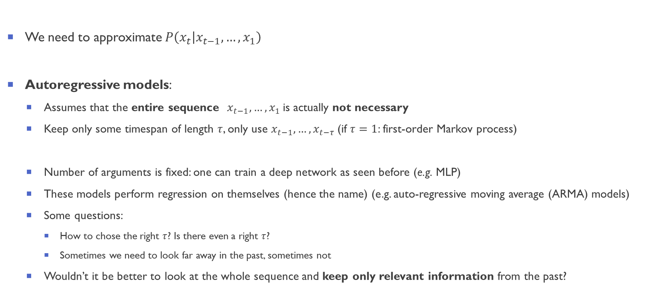
Autoregressive models
We need to approximate $P\left(\left.x_{t}\right|x_{t−1},…,x_{1}\right)$
Autoregressive models:
Assumes that the entire sequence $x_{t−1},…,x_{1}$is actually not necessary
Keep only some timespan of length $τ$, only use $x_{t−1},…,x_{t−τ}$(if $τ=1$: first-order Markov process)
Number of arguments is fixed: one can train a deep network as seen before (e.g. MLP)
These models perform regression on themselves (hence the name) (e.g. auto-regressive moving average (ARMA) models)
Some questions:
How to chose the right $τ$? Is there even a right $τ$?
Sometimes we need to look far away in the past, sometimes not
Wouldn’t it be better to look at the whole sequence and keep only relevant information from the past?

Slide 8
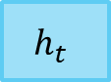
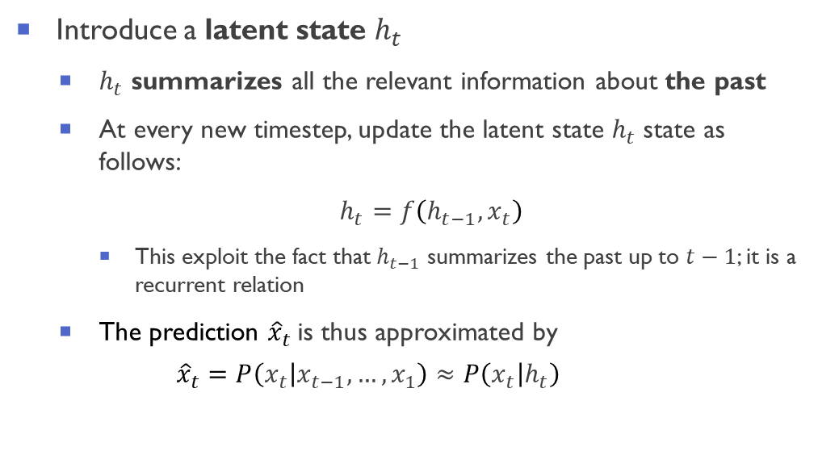
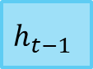
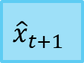
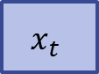
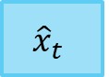
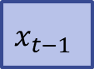
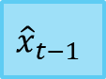
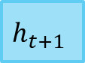
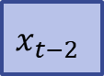
Latent autoregressive models
Introduce a latent state $h_{t}$
$h_{t}$ summarizes all the relevant information about the past
At every new timestep, update the latent state $h_{t}$state as follows:
$h_{t}=f\left(h_{t−1},x_{t}\right)$
This exploit the fact that $h_{t−1}$ summarizes the past up to $t−1$; it is a recurrent relation
The prediction ${\hat{x}}_{t}$is thus approximated by
$${\hat{x}}_{t}=P\left(\left.x_{t}\right|x_{t−1},…,x_{1}\right)≈P\left(\left.x_{t}\right|h_{t}\right)$$
$${\hat{x}}_{t−1}$$
$${\hat{x}}_{t}$$
$${\hat{x}}_{t+1}$$
$$h_{t−1}$$
$$h_{t}$$
$$h_{t+1}$$
$$x_{t−2}$$
$$x_{t−1}$$
$$x_{t}$$
Arbitrary length sequence $x_{t−1},…,x_{1}$mapped to a fixed length vector $h_{t}$ → $h_{t}$is a lossy summary of the past
Recurrent neural networks (RNNs) aim at learning this (crucial) mapping function from data

Slide 9
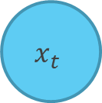
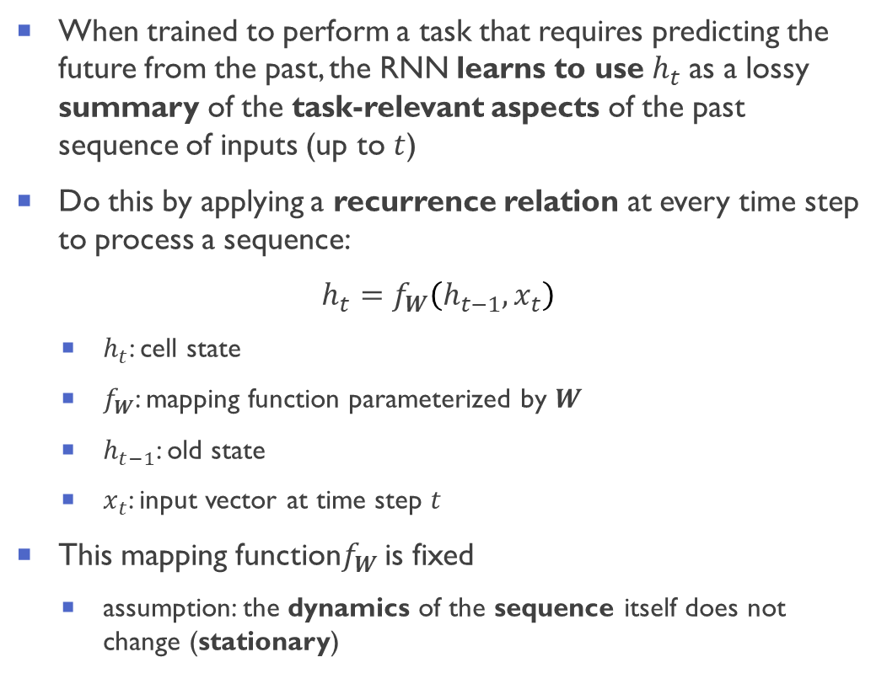
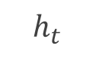
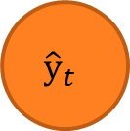
Recurrent Neural Network (RNN)
When trained to perform a task that requires predicting the future from the past, the RNN learns to use $h_{t}$ as a lossy summary of the task-relevant aspects of the past sequence of inputs (up to $t$)
Do this by applying a recurrence relation at every time step to process a sequence:
$h_{t}=f_{W}\left(h_{t−1},x_{t}\right)$
$h_{t}$: cell state
$f_{W}$: mapping function parameterized by $W$
$h_{t−1}$: old state
$x_{t}$: input vector at time step $t$
This mapping function$f_{W}$ is fixed
assumption: the dynamics of the sequence itself does not change (stationary)
$${\hat{y}}_{t}$$
Output vector
RNN
recurrent cell
$$h_{t}$$
$$x_{t}$$
Input vector

Slide 10
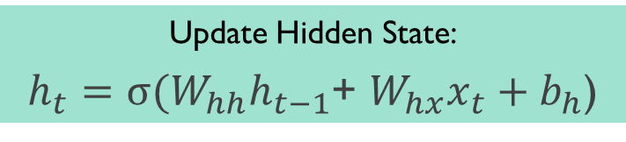



RNN state update and output
$${\hat{y}}_{t}$$
Output Vector
$${\hat{y}}_{t}=W_{yh}h_{t}+b_{y}$$
Output vector
RNN
recurrent cell
Update Hidden State:
$h_{t}=σ(W_{hh}h_{t−1}$+ $W_{hx}x_{t}+b_{h}$)
$$h_{t}$$
$$x_{t}$$
Input vector
$\text{Input} \text{vector}$:
$$x_{t}$$

Slide 11
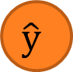

MLP, and RNN modelling for sequence data
$$\hat{y}$$
Other architectures are possible
$$x$$
Many to One
Sentiment Classification
Spectrum to property
Many to Many
Machine Translation – Text generation
One to One
“Vanilla” neural network
(e.g. MLP)

Slide 12
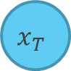
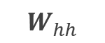
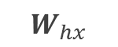
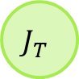
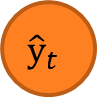
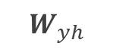
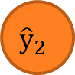



















Unfolding the RNN: computational graph across time
$$J$$
Forward pass
$$J_{0}$$
$$J_{2}$$
$$J_{T}$$
$$J_{1}$$
$${\hat{y}}_{t}$$
$${\hat{y}}_{0}$$
$${\hat{y}}_{1}$$
$${\hat{y}}_{2}$$
…
$${\hat{y}}_{T}$$
$$W_{yh}$$
$$W_{yh}$$
$$W_{yh}$$
$$W_{yh}$$
RNN
=
…
$$W_{hh}$$
$$W_{hh}$$
$$W_{hh}$$
$$W_{hx}$$
$$W_{hx}$$
$$W_{hx}$$
$$W_{hx}$$
$$x_{0}$$
$$x_{1}$$
$$x_{2}$$
…
$$x_{T}$$
$$x_{t}$$
The same weight matrices are re-used at every step
Assumption: the dynamics of the sequence itself does not change (stationary)

Slide 13

RNN: backpropagation trough time
$$J$$
Forward pass
$$J_{0}$$
$$J_{1}$$
$$J_{2}$$
$$J_{T}$$
Backward pass
$${\hat{y}}_{t}$$
$${\hat{y}}_{0}$$
$${\hat{y}}_{1}$$
$${\hat{y}}_{2}$$
…
$${\hat{y}}_{T}$$
$$W_{yh}$$
$$W_{yh}$$
$$W_{yh}$$
$$W_{yh}$$
RNN
=
…
$$W_{hh}$$
$$W_{hh}$$
$$W_{hh}$$
$$W_{hx}$$
$$W_{hx}$$
$$W_{hx}$$
$$W_{hx}$$
$$x_{0}$$
$$x_{1}$$
$$x_{2}$$
…
$$x_{T}$$
$$x_{t}$$

Slide 14
















Standard RNN gradient flow: some considerations
The loss function $J$depends on the errors at all time steps:
$$J=\frac{1}{T}\sum_{t=1}^{T}{J_{t}\left({\hat{y}}_{t},y_{t}\right)}$$
To train the network, we need to calculate the gradients $\frac{∂J}{∂W_{hx}}$ and $\frac{∂J}{∂W_{hh}}$ of the loss function $J$ w.r.t. the network parameters $W_{hh}$ and $W_{hx}$
We have done the same for MLPs in the previous lecture
$$J$$
$$J_{0}$$
$$J_{1}$$
$$J_{2}$$
$$J_{T}$$
$${\hat{y}}_{0}$$
$${\hat{y}}_{1}$$
$${\hat{y}}_{2}$$
…
$${\hat{y}}_{T}$$
$$W_{yh}$$
$$W_{yh}$$
$$W_{yh}$$
$$W_{yh}$$
…
$$W_{hh}$$
$$W_{hh}$$
$$W_{hh}$$
$$W_{hx}$$
$$W_{hx}$$
$$W_{hx}$$
$$W_{hx}$$
$$x_{0}$$
$$x_{1}$$
$$x_{2}$$
…
$$x_{T}$$
However, in RNN is more complicated because $h_{t}$depends recursively on hidden states at all previous timesteps through the recurrent relation
$h_{t}=f_{W}\left(h_{t−1},x_{t}\right)$ or equivalently $h_{t}=σ(W_{hh}h_{t−1}$+ $W_{hx}x_{t}+b_{h}$)
Repeated application of the chain rule

Slide 15




Standard RNN gradient flow: vanishing and exploding gradients
It can be shown (neglecting biases and activation function in the hidden layer being the identity) [1] :
$\frac{∂J}{∂W_{hx}}=\sum_{t=1}^{T}{prod\left(\frac{∂J}{∂h_{t}},\frac{∂h_{t}}{∂W_{hx}}\right)}=\sum_{t=1}^{T}{\frac{∂J}{∂h_{t}}}x_{t}^{\text{⊤}}$
$\frac{∂J}{∂W_{hh}}=\sum_{t=1}^{T}{prod\left(\frac{∂J}{∂h_{t}},\frac{∂h_{t}}{∂W_{hh}}\right)}=\sum_{t=1}^{T}{\frac{∂J}{∂h_{t}}}h_{t−1}^{\text{⊤}}$
where the central quantity (affecting numerical stability) is $\frac{∂J}{∂h_{t}}$:
$$\frac{∂J}{∂h_{t}}=\sum_{t=1}^{T}{{\left(W_{hh}^{\text{⊤}}\right)}^{T−1}W_{yh}^{\text{⊤}}\frac{∂J}{∂{\hat{y}}_{T+t−i}}}$$
$\frac{∂J}{∂h_{t}}$ involves large powers of $W_{hh}^{\text{⊤}}$ for long sequence models (scales as the # of input steps $T$)
This leads to the so-called “exploding and vanishing gradient problem” in standard RNN
[1] 8.7. Backpropagation Through Time — Dive into Deep Learning 0.15.1 documentation (d2l.ai)

Slide 16


















Standard RNN gradient flow: vanishing and exploding gradients
$$h_{0}$$
$$h_{1}$$
$$h_{2}$$
$$h_{T}$$
$$W_{hh}$$
$$W_{hh}$$
$$\frac{∂J}{∂h_{t}}=\sum_{t=1}^{T}{{\left(W_{hh}^{\text{⊤}}\right)}^{T−1}W_{yh}^{\text{⊤}}\frac{∂J}{∂{\hat{y}}_{T+t−i}}}$$
$$W_{hh}$$
$$W_{hx}$$
$$W_{hx}$$
$$W_{hx}$$
$$W_{hx}$$
$$x_{0}$$
$$x_{1}$$
$$x_{2}$$
…
$$x_{T}$$
Computing the gradient $\frac{∂J}{∂h_{0}}$ involves many factors of $W_{hh}$ and a repeated gradient computation
Many (eigen)values of $W_{hh}$ $> 1$:
exploding gradients
Many (eigen)values of $W_{hh}$ $< 1$:
vanishing gradients
Solution (easy):
Gradient clipping to scale large gradients
Solution (hard):
Some heuristics (activation functions, weight initialization)
Specialized network architectures

Slide 17


The need for specialized neural network architectures for sequences
Observation 1: Long sequences are needed to accomplish most tasks:
Bob and Alice are going out for a walk. Bob picks and gives _____ a flower.
My name is Paul, I am German, currently living in Florence. I love the food and the people, but I really miss speaking ______ .
Observation II: not all observations in a sequence are equally relevant
Main idea to accomplish that: build-in mechanisms in the RNN to remember only relevant observations
Mechanism to pay attention (i.e. Is the input at the current timestep relevant for the task?) – Input gate
Mechanism to forget (i.e. Is some past information now irrelevant for the task?) – Forget gate
Mechanism to easily carry over the information to the next steps – Memory Cell (cell state)
This is accomplished through specialized architectures for sequences: most popular are LSTM or GRU

Slide 18
Lecture 2 Outline
Part 1.
Recurrent Neural Networks (RNNs)
1
Part 2.
Long Short Term Memory (LSTM)
2
Part 3.
Generative Adversarial Networks (GANs)
3
Part 4.
Miscellaneous
4

Slide 19

Simple RNN: one simple layer
The repeating module in a standard RNN contains a single layer:
[LSTM paper] Hochreiter and Schmidhuber, Neural Computation 9(8):1735, (1997)
Figure from d2l.ai (https://d2l.ai/chapter_recurrent-neural-networks/rnn.html

Slide 20

Long Short Term Memory (LSTM): four interacting layers instead of one
The repeating module in an LSTM contains four interacting layers:
[LSTM paper] Hochreiter and Schmidhuber, Neural Computation 9(8):1735, (1997)
Figure from d2l.ai (https://d2l.ai/chapter_recurrent-neural-networks/rnn.html)

Slide 21

The Core Idea Behind LSTMs: gated memory cell
LSTM’s design is inspired by logic gates of a computer
LSTM introduces a memory cell (or cell for short) that has the same shape as the hidden state engineered to record additional information.
This allows to information to easily flow from one step to the next
Information is added or removed through structures called gates
Gates are composed by a sigmoid neural net layer and a pointwise multiplication operation
The sigmoid layer outputs numbers between zero and one, describing how much of each component should be let through
Figures from d2l.ai (https://d2l.ai/chapter_recurrent-neural-networks/rnn.html)

Slide 22



LSTM: remembering what is important through memory cell and gates
Different gates control the memory cell
Forget gate: mechanism to reset the content of the cell
Input gate: decides when to read data into the cell.
Output gate: reads out the entries from the cell
Motivation: to be able to decide when to remember and when to ignore inputs in the hidden state via a dedicated mechanism
Implements the main idea (discussed before) for sequence learning: build-in mechanisms in to remember only relevant observations
From d2l.ai (https://d2l.ai/chapter_recurrent-neural-networks/rnn.html)

Slide 23


Input gate, forget gate, output gate
Data feeding into the LSTM gates are
input at the current time step $x_{t}$
hidden state of the previous time step $h_{t−1}$
Data processed by three fully-connected layers with a sigmoid activation function to compute the values of the input, forget and output gates:
$i_{t}=σ(W_{ix}x_{t}$+ $W_{ih}h_{t−1}+b_{i}$)
$f_{t}=σ(W_{fx}x_{t}$+ $W_{fh}h_{t−1}+b_{f}$)
$o_{t}=σ(W_{ox}x_{t}$+ $W_{oh}h_{t−1}+b_{o}$)
where $W_{ix}$, $W_{fx}$, $W_{ox}$, $W_{ih}$, $W_{fh}$, $W_{oh}$ are weight parameters and $b_{i}$, $b_{f}$, and $b_{o}$ are bias parameters
As a result of the sigmoid activation, values of the three gates are in the range of $(0,1)$
From d2l.ai (https://d2l.ai/chapter_recurrent-neural-networks/rnn.html)

Slide 24



Candidate memory cell
We introduce the candidate memory cell
It builds the candidate update for the memory cell
It is a fully-connected layer (like the other gates), but using a $tanh⁡$function instead:
$${\tilde{c}}_{t}=\tanh\left(W_{cx}x_{t}\text{+} W_{ch}h_{t−1}+b_{c}\right)$$
where $W_{cx}$, $W_{ch}$ are weight parameters and $b_{c}$ is a bias parameter
${\tilde{c}}_{t}$is in the range for $(−1,1)$ as the activation function.
From d2l.ai (https://d2l.ai/chapter_recurrent-neural-networks/rnn.html)

Slide 25




Memory cell update
We need a mechanism to govern input and forgetting
Two gates for this:
Input gate $i_{t}$: decides how much we take data into account via the candidate cell ${\tilde{c}}_{t}$
Forget gate $f_{t}$: decides how much of the old memory cell content $c_{t}$we keep
Update equation for the memory cell:
$$c_{t}=f_{t}⊙c_{t−1}+i_{t}⊙{\tilde{c}}_{t}$$
where $⊙$ indicates elementwise multiplication
If $f$ gate is always approximately $1$ and the $i$is always approximately $0$, the past memory cells $c_{t−1}$will be saved over time and passed to the current time step (no reliance on gradients)
alleviates the vanishing gradient problem and to better capture long range dependencies within sequences
From d2l.ai (https://d2l.ai/chapter_recurrent-neural-networks/rnn.html)

Slide 26



Hidden state update
We need compute the update of the hidden state $h_{t}$
In LSTM, the hidden state is simply a gated version of the $tanh⁡$ memory cell
Output gate $o_{t}$: decides how much data will be copied from the memory cell $c_{t}$to the hidden state $h_{t}$
Update equation for hidden state $h_{t}$:
$$h_{t}=o_{t}⊙tanh⁡(c_{t})$$
where $⊙$ indicates elementwise multiplication
If $o_{t}$ approximates $1$: pass all memory information through to the predictor
If $o_{t}$ approximates $0$: retain all the information only within the memory cell

Slide 27
LSTM applications
LSTM have been tremendously successful in modelling long-term dependencies in sequences
Examples of tasks performed with LSTM:
Time-series prediction
Speech recognition
Handwritten recognition
Sentiment classification (does this text has a positive, negative, or neural sentiment?)
Machine translation
Music generation
Robot control
Trajectory prediction in self driving cars
From Wikipedia (https://en.wikipedia.org/wiki/Long_short-term_memory)

Slide 28
LSTM real-world applications
LSTM has numerous applications in the real world [*]
2015:
Google started using an LSTM for speech recognition on Google Voice. According to the official blog post, the new model cut transcription errors by 49%.
2016:
Google released the Google Neural Machine Translation system for Google Translate which used LSTMs to reduce translation errors by 60%.
Apple announced in its Worldwide Developers Conference that it would start using the LSTM for quicktypein the iPhone and for Siri.
Amazon released Polly, which generates the voices behind Alexa, using a bidirectional LSTM for the text-to-speech technology.
2017: Facebook performed some 4.5 billion automatic translations every day using long short-term memory networks
Currently the new state-of-the-art systems for sequence modellings are attention-based systems
Key publication: Vaswani et al., Attention Is All You Need, ArXiv:1706.03762 (2017)
[*] From Wikipedia (https://en.wikipedia.org/wiki/Long_short-term_memory)

Slide 29


Deep RNN
So far, only a single layer architecture,
We can however add more layers to make the model more flexible (and powerful)
flexible because it allows to extract information at different levels
Examples:
Financial data: high-level data about financial market conditions (bear or bull market) available lower level: only record shorter-term temporal dynamics.
Physics: high-level data about general behavior described by an effective theory; low-level: deviations from the effective theory due to interactions
Deep simply means adding more layers
Stack multiple layers of RNNs on top of each other.
Each hidden state is continuously passed to both the next time step of the current layer and the current time step of the next layer
Deep RNN with $L$ hidden layers.
Figure from d2l.ai (https://d2l.ai/chapter_recurrent-modern/deep-rnn.html)

Slide 30

Revealing ferroelectric switching character using deep recurrent neural networks [1]
Band-excitation piezoresponse (BEPS) force microscopy is used to characterize the nanoscale-switching processes (a variant of atomic force microscopy)
Raw data is high-dimensional (amplitude, phase, resonance frequency, and quality factor of the cantilever resonance) and are are qualitative measures of piezoresponse, polarization direction, stiffness, and dampening
Information of physical significance lies on a data manifold with a much lower dimensionality; however, no means to predict the manifold
LSTM autoencoder can be used to learn characteristic mechanisms of response from multichannel hyperspectral BEPS
This new capability provides a process to quantify subtle differences in switching mechanisms
[1] Agar et al., Nature Comm. 10, 4809 (2019)

Slide 31

Bi-directional RNN
Often context is crucial to have a good prediction
A) I ran 25km today, so I am ______
B) Today I am ______ because I ran 25 km.
So far, we only gave past observation to the current state
Our model will fail in scenario B)
Two RNNs:
One RNN going forward mode starting from the first sample
One RNN going backwards starting from the last sample
Use only if you are okay with using the “future” to predict the present (application dependent)
Good example: if the sequence is a spectrum, it does make sense to use higher frequencies to predict lower frequencies
Bad example: predicting the time evolution of a system
Bi-directional RNN

Slide 32
Tutorials: recurrent neural networks
We will use the (great) tutorial from Dive into Deep Learning (http://d2l.ai/)
Recurrent neural networks from scratch: 8.5. Implementation of Recurrent Neural Networks from Scratch — Dive into Deep Learning 0.17.0 documentation (d2l.ai)
Link: http://d2l.ai/chapter_recurrent-neural-networks/rnn-scratch.html
PyTorch implementation: rnn-scratch.ipynb - Colaboratory (google.com)
Recurrent neural networks (concise implementation): 8.6. Concise Implementation of Recurrent Neural Networks — Dive into Deep Learning 0.17.0 documentation (d2l.ai)
Link: http://d2l.ai/chapter_recurrent-neural-networks/rnn-concise.html
PyTorch implementation: rnn-concise.ipynb - Colaboratory (google.com)
Long short-term memory (LSTM): 9.2. Long Short-Term Memory (LSTM) — Dive into Deep Learning 0.17.0 documentation (d2l.ai)
Link: http://d2l.ai/chapter_recurrent-modern/lstm.html
PyTorch implementation: lstm.ipynb - Colaboratory (google.com)

